Slide 1
PRADHAN MANTRI AWAAS YOJANA – GRAMIN
Department of Housing – Karnataka

Slide 2
Sanction of houses
Series Year | Target | Sanction
2016-2017 | 80272 | 80272
2017-2018 | 43816 | 43816
2019-2020 | 42267 | 42267
2021-2022 | 141391 | 81429
TOTAL | 307746 | 247784
The houses from FY 2016-17 to 2019-2020 are sanctioned through GoK website.
No houses are pending for sanction for FY 2016-17 to 2019-20, as the old PWL is exhausted and untilised target was also surrendered.
Government of Karnataka is using Awaassoft website for implementation of PMAY-G scheme in 2021-22 series year.
Department of Housing – Karnataka

Slide 3
Completion of houses
Completion of Houses
Year | GoI Target | Selection | Revised Target * | Completed | Foundation | Lintel | Roof | Progress Total | Unstarted | Block
2016-2017 | 93065 | 92394 | 80272 | 70242 | 5804 | 2040 | 1515 | 9359 | 0 | 12793
2017-2018 | 52284 | 54629 | 43816 | 38513 | 3912 | 1921 | 1815 | 7648 | 0 | 8468
2019-2020 | 86000 | 40694 | 42267 | 14495 | 3776 | 1802 | 1722 | 7300 | 16611 | 2288
2021-2022 | 141391 | 81429 | 141391 | 16 | 0 | 0 | 0 | 0 | 81413 | 0
TOTAL | 372740 | 269146 | 307746 | 123266 | 13492 | 5763 | 5052 | 24307 | 98024 | 23549
* After surrender of houses:
21,261 unstarted houses of 2016-17 and 2017-18 (12793+8468)
43733 unutilized target of 2019-2020 as the PWL was exhausted
Department of Housing – Karnataka

Slide 4
Release of Central and State Share
Rs. In Crs.
Series Year |  | Allocation |  |  | Release |  |  | Series Year Expenditure
 |  | Central Share | State Share | Total | Central Share | State Share | Total
2016-17 | 93065 | 670.06 | 639.88 | 1309.94 | 670.06 | 639.88 | 1309.94 | 948.38
2017-18 | 52284 | 376.44 | 363.45 | 739.89 | 376.44 | 363.45 | 739.89 | 499.04
2019-20 | 42267 | 304.32 | 222.20 | 526.52 | 309.60 | 222.20 | 531.80 | 181.11
2021-22 | 141391 | 1018.02 | 1145.27 | 2163.28 | 214.92 | 143.00 | 357.92 | 97.18
Total | 329007 | 2368.84 | 2370.80 | 4739.63 | 1571.02 | 1368.53 | 2939.55 | 1725.71
Amount Spent for IAY Backlog Series |  |  |  |  |  |  |  | 476.00
Total Expenditure |  |  |  |  |  |  |  | 2201.71
Actual Balance under PMAY-G |  |  |  |  |  |  |  | 737.84
Allocation and releases includes additional state share of SC/ST Beneficiaries beared from State Government
SNA balance is Rs.669.73 Crores and Balance amount is in Additional state share A/C
An amount of Rs. 476 crs has been spent from PMAY -G for IAY backlog houses. GoK has requested for reimbursement of the same.
2023-2024 budget allocation – Rs. 410 crs.
Department of Housing – Karnataka

Slide 5
Convergence
Convergence
Instructions were given to the field officials to assist the PMAY (G) beneficiaries to avail benefits under Swacch Bharat Mission, MGNREGS and any other such schemes of MoRD.
As per Social audit, around 1,02,058 PMAY G beneficiaries were provided basic amenities viz., toilets, electricity, drinking water, Gas by converging with GoI schemes Ujjwala, SBM etc.,
Department of Housing – Karnataka

Slide 6
Social Audit
Social Audit
Work order issued Directorate of Social Audit, RDPR Dept. The project cost is Rs. 2.23 Crs. 40% of amount released.
As per RDPR, as on date, out of 6024 GPs social audit is completed in 4841 GPs.
The Project is still in progress.
Department of Housing – Karnataka

Slide 7
Rural Mason Training
Rural Mason Training
GOI has allocated a target of 7319 from 2016-17 to 2019-20.
Work order issued to 5 Training Providers to conduct RMT in 226 Talukas for 7319 trainees.
As on date, training has been completed for 5250 masons. Remaining is under progress.
Assessment completed for 3765 trainees.
Necessary action is being taken to complete the RMT in time.
Department of Housing – Karnataka

Slide 8
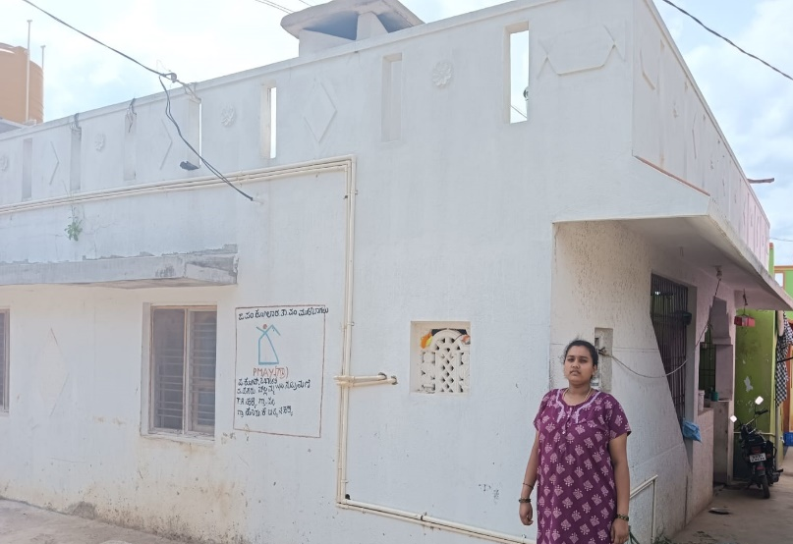
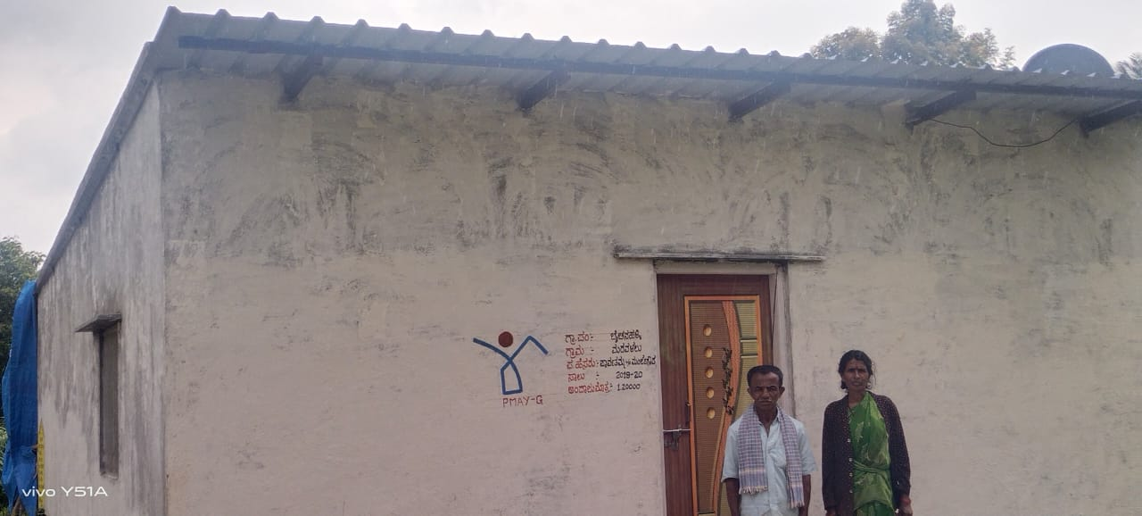
Houses Constructed under PMAYG
Beneficiary Name : Challamma W/O Subramani
District : Kolar
Block / Taluk : Mulabagil
Gram Panchayat : T.R. Halli
Beneficiary Name : Parvathamma W/o Manjegowda
District : Hassan
Block / Taluk : Arakalagudu
Gram Panchayat : Baichanahalli
Department of Housing – Karnataka

Slide 9
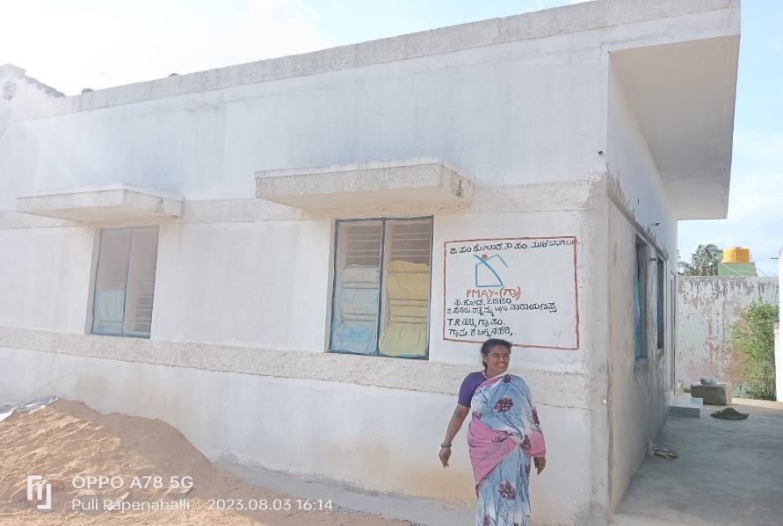
Houses Constructed under PMAYG
Beneficiary Name : Ratnamma W/o Narayanappa
District : Kolar
Block / Taluk : Mulabagil
Gram Panchayat : T.R. Halli
Department of Housing – Karnataka

